Slide 1
Environmental awareness
by Bekbayev Askhat 0A02

Slide 2
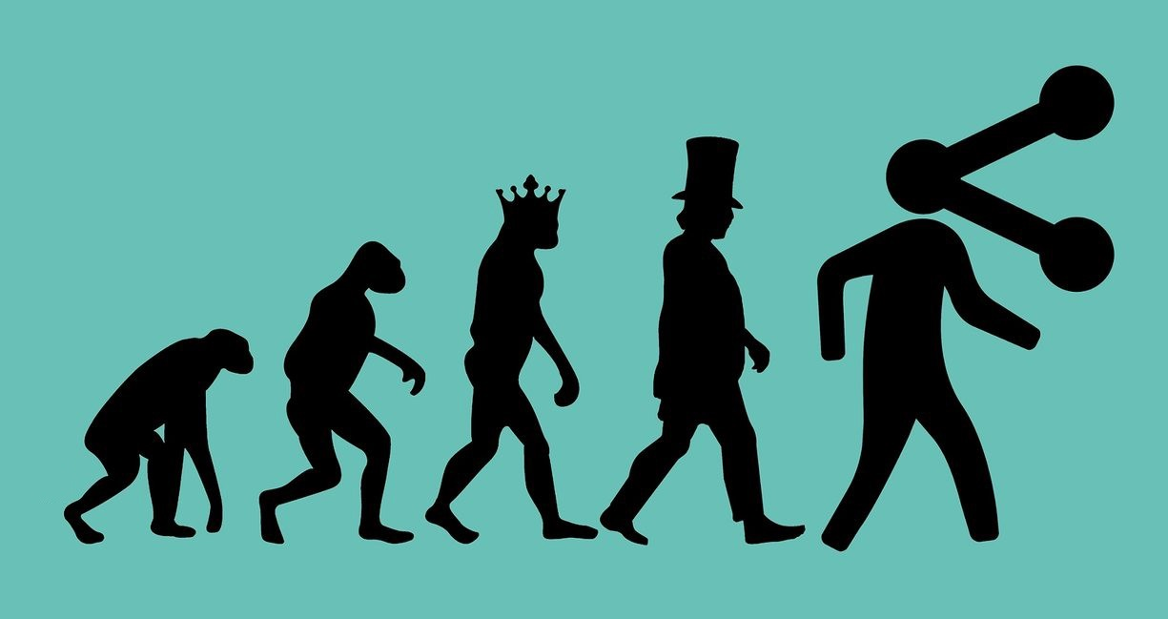
World is changing
New factories and buildings
Populations is growing
New technologies

Slide 3

We are all connected
New communication technologies

Slide 4
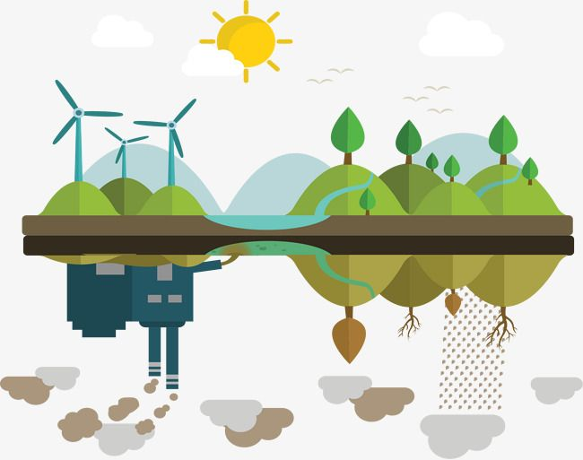



Pollution
Deforestation
Plastic production
Oil drilling

Slide 5
Ignoring makes things worse
*According to glocalities research. In USA. For 2019 year.

Slide 6
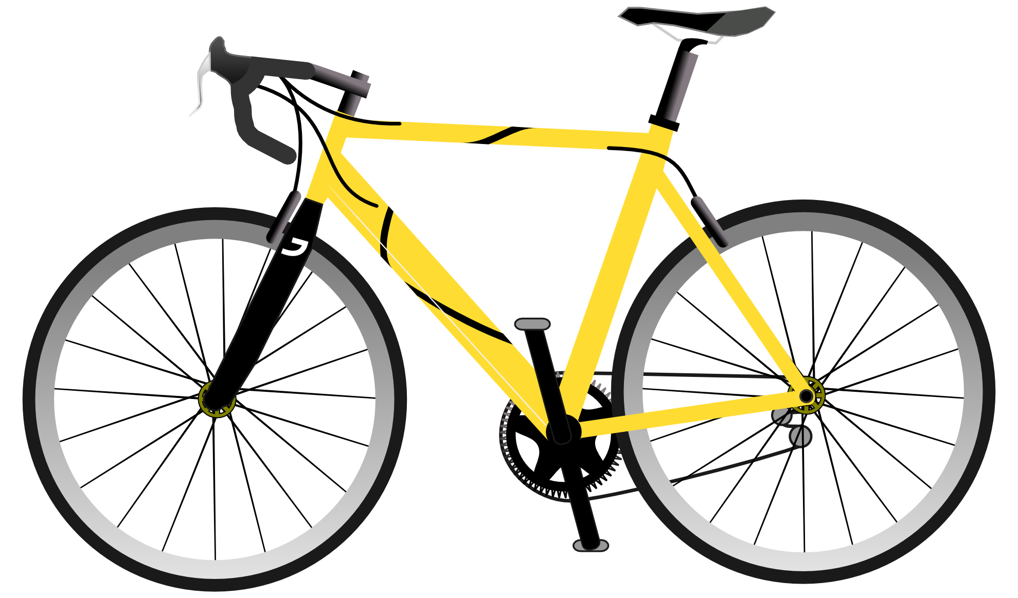



What can we do?
Bike or bus
Clean power
Reusable products
Farmers

Slide 7


